Slide 1

CPE 490 Embedded Systems Lecture 11
C language:
selection
Iterations
Loops
Strings, and string functions

Slide 2
Exam 1
Scheduled for a week from today. I would like to move it to Thursday so we can get one more homework assignment in.

Slide 3
Program Control Statements in C
Selection
if else, ?, switch
Iteration
for, while, do while
Jump
break, continue, return, goto

Slide 4
Selection: if and else
Prototype 1
If(condition) statement;
else statement;
Prototype 2
If(condition)
{
statement block1
}
else
{
statement block2
}

Slide 5
Nested Ifs
There is not else if construct in C but the same results can be obtained by nesting if statements
If (i) {
if(j) statement1;
if(k) statement2;
else statement 3;
statement4;
}
else {
if (z) statement 5;
else statement 6;
}
Notes:
What are the conditions for statement 1 to run? i and j
What are the conditions for statement 2 to run? i and k (but statement 1 could run also!)
What are the conditions for statement 3 to run? i and !k (but statement 1 could run also!)
What are the conditions for statement 4 to run? i (but statement 1,2, or 3 could run also!)
What are the conditions for statement 5 to run? !i and z
What are the conditions for statement 6 to run? !i and !z
Note if(z) is like a ‘else if’ statement. That is if you want mutually exclusive events be careful the next if must come in the else block.

Slide 6
Shorthand if Statement
Prototype
Variable = Exp1 ? Exp2 : Exp 3
Where:
Exp1 is evaluated to be true or false
Exp2 becomes the value of the entire ? Expression if Exp 1 is true and Exp3 becomes the value if false.
Example:
done = count>0 ? 0 : 1; // done =0 if count >0 else 1

Slide 7
Selection: Switch Statement
Prototype
Switch(variable){
case constant1:
statement sequence
break;
…
case constant N:
statement sequence
break;
default:
statement sequence
}
Only one variable can be tested
No two case constants in the same switch can have identical values
More efficient and easier to read than nested if
Default statement is optional if no default no statement sequence is executed when no case is true
Nested switches are allowed
Notes:
Much easier to read than nested ‘if else’ statements

Slide 8
switch Without break
Break is optional but all remaining statement sequence statements will execute until a break is encountered or the end bracket is encountered.
What will the following do if i=2?
switch (i) {
case 1:
case 2:
case 3: do_something();
break;
case 4: do_something_else();
break;

Slide 9
Iteration: for Loops
Prototype:
For(initialization; condition; increment) statement;
Example:
for (i=100; i>-100; i =i-5) y[i] = i/5;
Prototype:
for (initialization; condition; increment)
{
code to be repeated
}
Example
for (i=100; i>-100; i =i-5)
{
y[i] = i/5;
}
Notes:
The code will not run if the condition is not initial met.

Slide 10
Loop Variations
Multiple indexes:
For( x=0, y=10; x<=10; ++x, --y) table[x,y] = x+y;
Missing Pieces:
For(x=0; x!=123;)
{ statements
}
Infinite Loop
for (;;)
{ statements
}

Slide 11
Iteration: while Loop
In c the while keyword will cause a statement or a group of statements to execute repeatedly as long as a condition is true.
The general while structure is:
while (conditional expression) statement;
The condition can be a logical or relational statement.
A single statement can be replaced by a block of statements located inside curly brackets {}

Slide 12
while loop example
# define TRUE 1
main ()
{
// initialization code
while (TRUE)
{
// code that will be repeated while the processor has power
}
}
Notes:
Notice that the while loop will run forever the condition is always true.
If the processor resets than you must wait for reboot, and then the c0 code and then the initialization code will run, in contrast if you use an endless while loop so that you never have to execute a reset and this overhead code will not be rerun.

Slide 13
Iteration: do while Loop
Prototype:
do
{
statements;
} while(conditions);
Example:
do {
sState = getswitch();
} while(!sState);

Slide 14
Jump: break
break statement causes a loop to be exited immediately. If nested loops you will only exit the inner loop you are currently in.
Example:
int t;
for(; ; )
{
getstate(&t);
if (t) break;
}
Notes:
Is this call by value or reference?

Slide 15
Jump: continue
The continue statement forces the next iteration of the loop, skipping any code between itself and the test condition of the loop.
Example:
For(x=0; x=100; x++)
{
if (x%2) continue;
flashLED();
}

Slide 16
Jump: return and goto
return statement is used in functions and will accomplish 2 things
Will cause the immediate return from the function to the calling code
Allows a value to be assigned to the return value that is declared in the function prototype.
goto will cause a jump to a label in the program:
goto nextpart;
…
nextpart:
……..

Slide 17
Strings in C
Strings in C are just character arrays variables terminated by a null (‘\0’) character.
This means that you must declare the array one larger then the number of characters you would like to hold:
char str[11]; can hold 10 characters in the string.
Remember all array indexes start at 0 so str[0] is the first char in the array and str[10] is the last in the above example.
Notes:
You will not get a compiler error if you declare the string to be too few characters it will just truncate at the point and not necessarily give you a null character at the end.

Slide 18
Strings in C
Sting constants appear in quotes, they get coded using ASCII 8 bit code.
Constant strings can be declared like:
char s[6] = “HELLO”;
The “HELLO” is considered a constant in C and the null character is automatically put at the end of the string.
The easiest way to declare string variables is to let the compiler do the counting:
char s[]=“HELLO”; is equivalent to
char s[6]={‘H’, ‘E’, ‘L’, ‘L’, ‘O’, ‘\0’};

Slide 19
Strings in C
Assigning a value to a char and performing arithmetic on it is no different than any integer type:
char c; // declare c as an 8-bit signed integer
c = ‘a’;
c++;
But you can not use an assignment statement for a string:
char s[15];
s = “HELLO”;
To do that you must use functions in the library or do it at initialization

Slide 20
String Function: strcpy
The statement #include <string.h> must be included to get common string functions
Prototype:
char *strcpy(char *s1, const char *s2);
strcpy (to,from) for example strcpy(s,”HELLO”);
Copies the constant character array “HELLO” to the character array s.
Bound checking is not done, so make sure “from” will fit inside “to”.
Notes:
Notice that if a string lilke “HELLO” is given C will give the a pointer to the beginning of the string address. The actual string is saved in a compilers string table.

Slide 21
String Function: strcat
#include <string.h>
Prototype:
char *strcat(char *s1, const char *s2);
Appends a copy of s2, the source string, to the end of the destination string s1.
Make sure strings s1 and s2 are null terminated!

Slide 22
Example of strcpy and strcat
The strings must be null terminated to work
main()
{
char s1[20], s2[10];
strcpy(s1, “hello”);
strcpy(s2, “ there”);
strcat(s1,s2);
}
s1 will equal “hello there”

Slide 23
String Function : strlen
#include <string.h>
Prototype:
size_t strlen(const char *s);
This function determines the length of the string, not including the terminating null character.

Slide 24
String Function : strcmp
#include <string.h>
Prototype:
int strcmp(const char *s1, const char *s2);

Slide 25
String Function
To find the length of a string
int i;
i = strlen(s);
To compare two stings use strcmp(s1,s2);
Returns a zero if they are equal
Returns positive number if s1>s2 lexicographically
Returns a negative number if s1<s2
Notes:
If the lengths are different but the value is equal up to the null the longer string is greater than the shorter string. The function will compare the first letter of each string if s1 is cat and s2 is dog then s1 < s2 .

Slide 26
String Constants
When a string constant is used in any type of expression, it is treated as pointer to the first character in the string.
The string itself has to be stored in nonvolatile program memory
Example of string constant being a pointer
main()
{
char *s;
s = “pointers are fun to use”;
}
Notes:
Remember if s was a type of char this would not work, s must be a pointer.

Slide 27
Dynamic Memory Allocation
Dynamic memory allocation occurs when objects are defined dynamically, at run time.
Using #include <stdlib.h> two commands can be used to allocate memory at run time
Void *malloc(size_t size); malloc returns a pointer of type void which can be assigned to any type of pointer. It takes an unsigned integer for the number of bytes
Void free(void *p) will free the memory pointed to by p
Notes:
We most likely will not need these commands in our labs. They are useful when the number of variables might be based upon an input. In this case at compile time it is impossible to know how much data space your are going to need.
size_t for our compiler is an unsigned int or 16 bits long, this can be made larger with a compiler inline command.

Slide 28
The Heap
The heap is the data memory that is left over after global variables, and reserved stack space is removed.
The heap is where the malloc space is created and freed.

Slide 29
String Constants in the dsPIC33
Consider the global decleration C statement:
char s[] = “CPE490 is awesome”;
3 things happen
The linker reserves a 18 byte contiguous set of memory location in RAM (assigned in near data)
The linker stores the 18 bytes value in program memory
The compiler creates a small routine to load the variable in RAM from the data in program memory.
Notes:
The routine will generated by the compiler and will run before main is executed this is the c0 code.

Slide 30
Using Constant To Control RAM use
Consider
const char s[] = “CPE490 is awesome”
By declaring the character array s as constant this will only create a constant string in program memory. RAM will not be allocated, and initialization code will not be created.
The string constant can be used in multiple places the compiler will only store one copy.

Slide 31
Program Access to Program Memory
There are two ways that the program can read program memory to get access to the constant strings
The Program Space Visibility (PSV) window (read only)
The table access instructions (read and write)

Slide 32
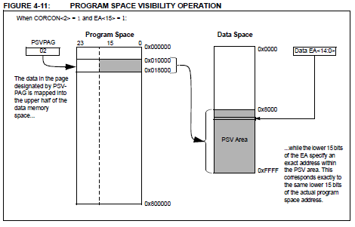
Program Space Visibility
Used for all string character constants
Notes:
MSB of the 24 bit instruction is not visible when using this mode. Therefore somewhat inefficient.

Slide 33
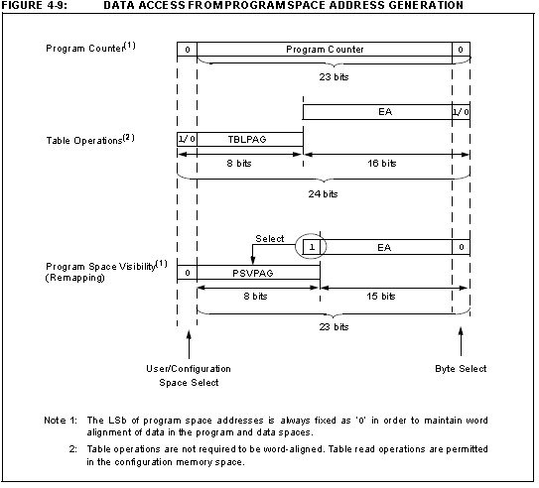
Program Space Visibility
Notes:
MSB of the 24 bit instruction is not visible when using this mode. Therefore somewhat inefficient.

Slide 34
Table Access Instructions
Table assembly instructions exist to read and write program memory.
All bytes of the program memory are available
These instruction are used in the compiler created initialization code .

